Slide 1


Slide 2
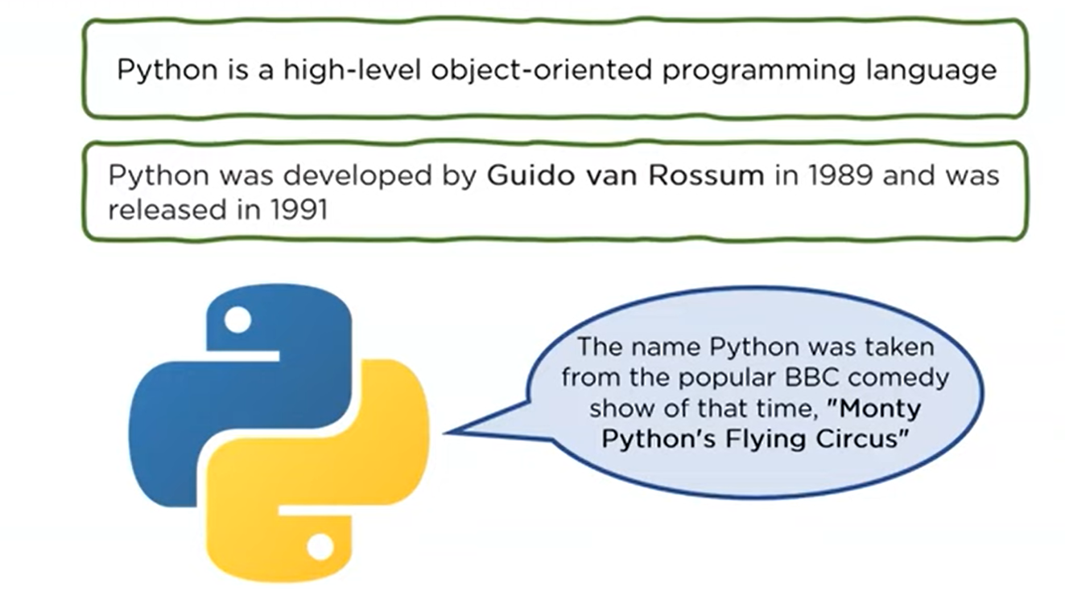
Introduction to Python

Slide 3
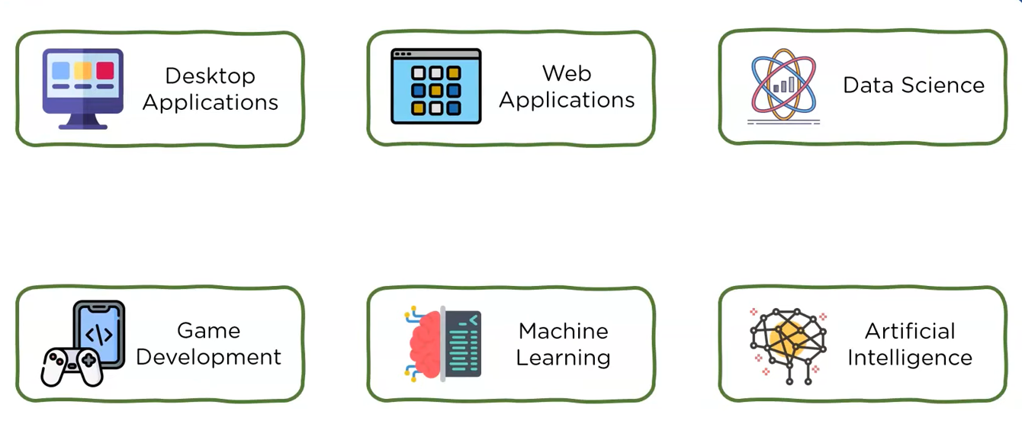
Uses of Python

Slide 4
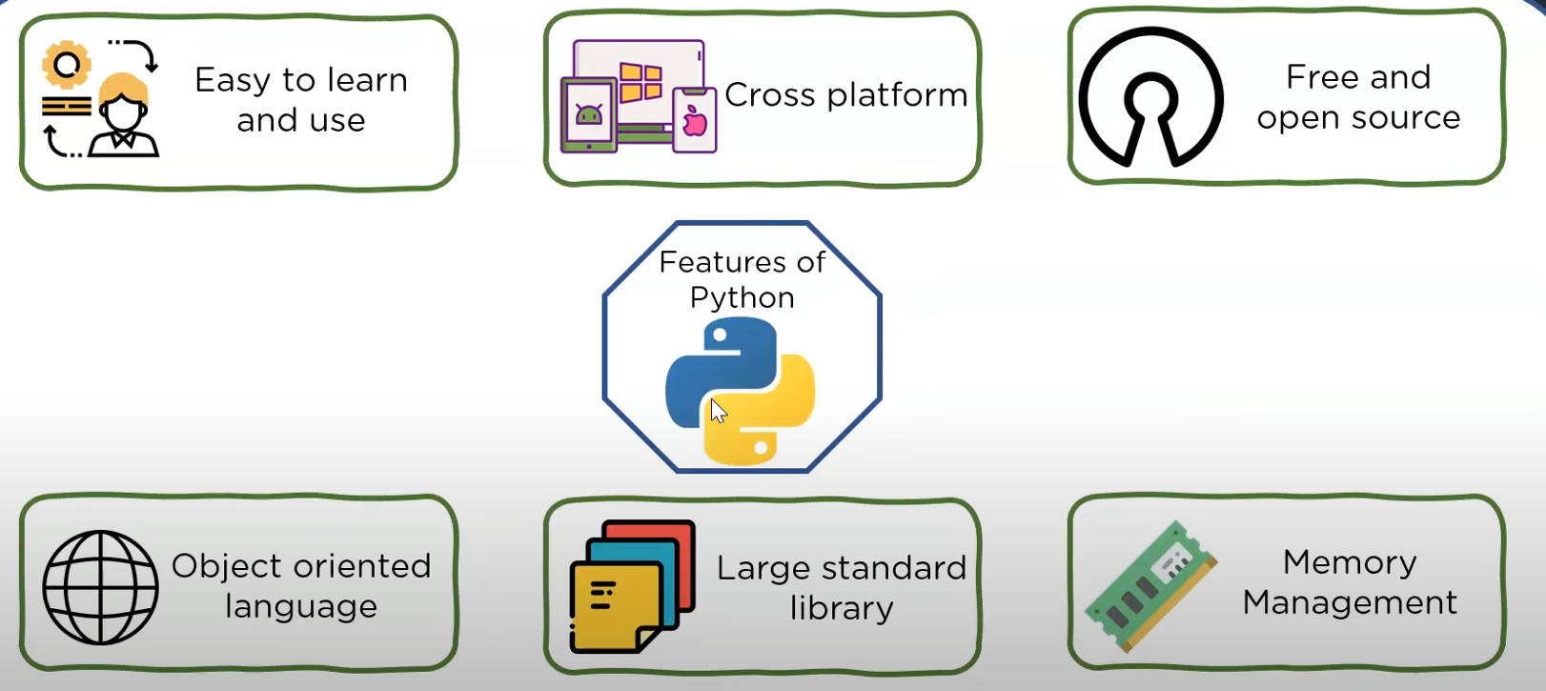
Features of Python

Slide 5
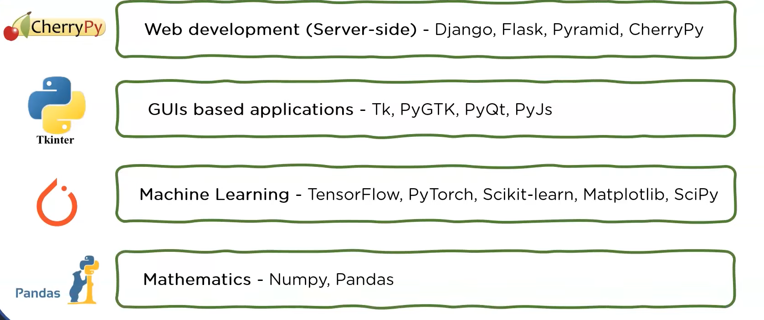
Popular Python Frameworks and Libraries

Slide 6
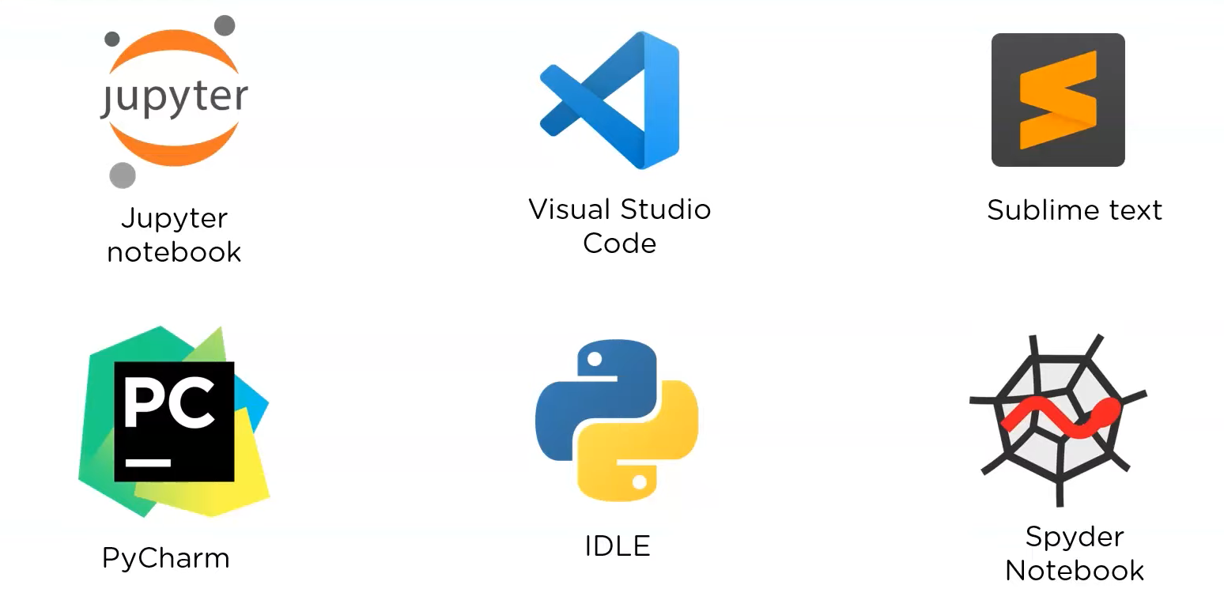
Best Python IDEs(Integrated devel. Envi.)

Slide 7
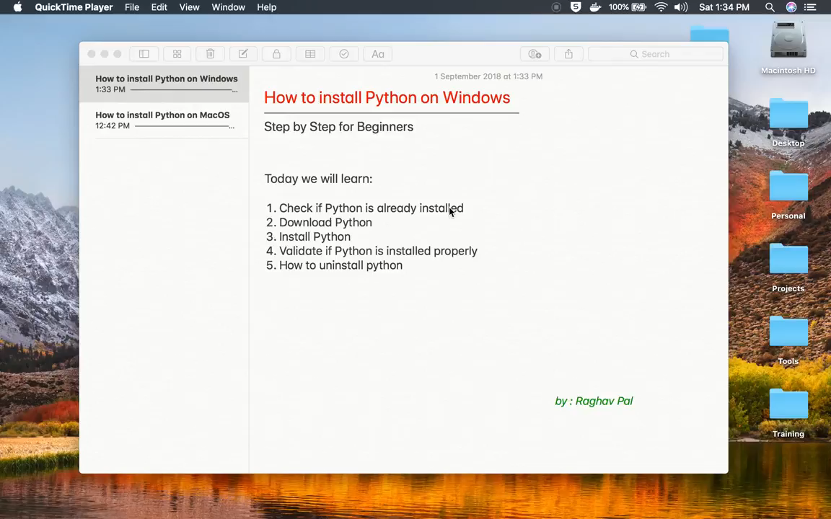
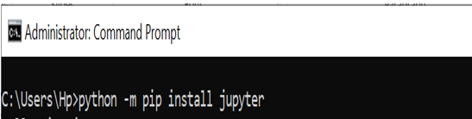
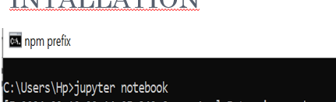
Installation (Python & Jupyter)
Note: Internet must be working while executing these commands

Slide 8
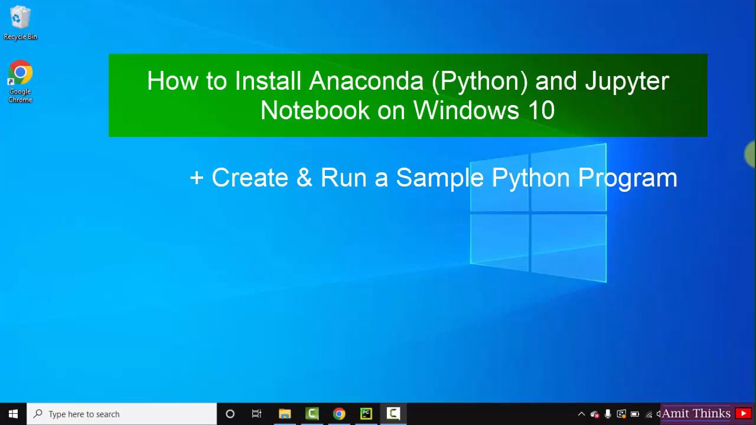
Installation (Anaconda)

Slide 9
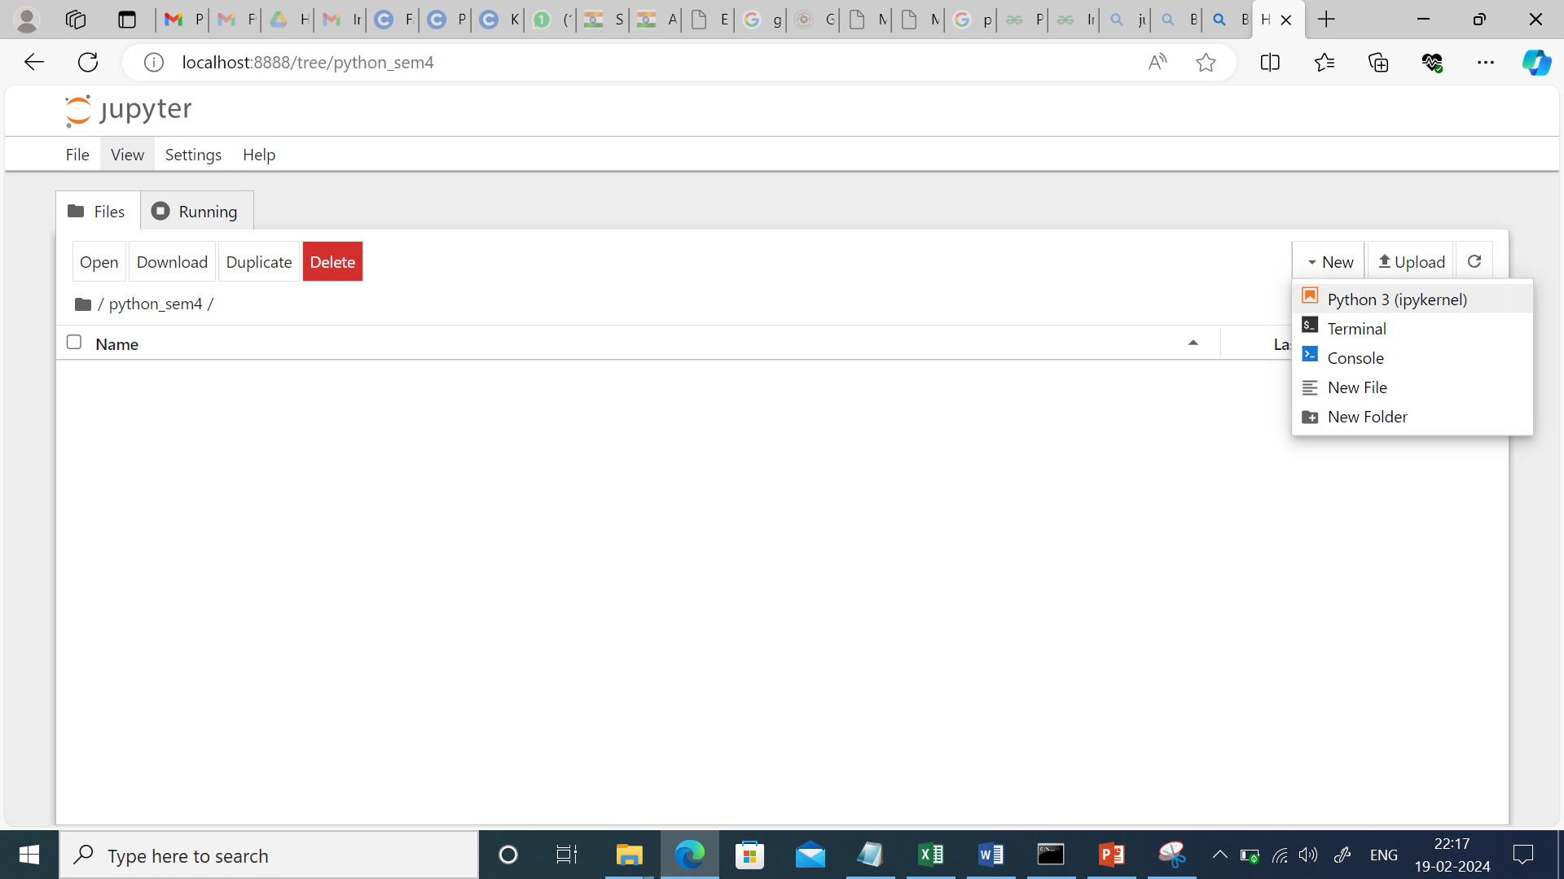
Jupyter View

Slide 10
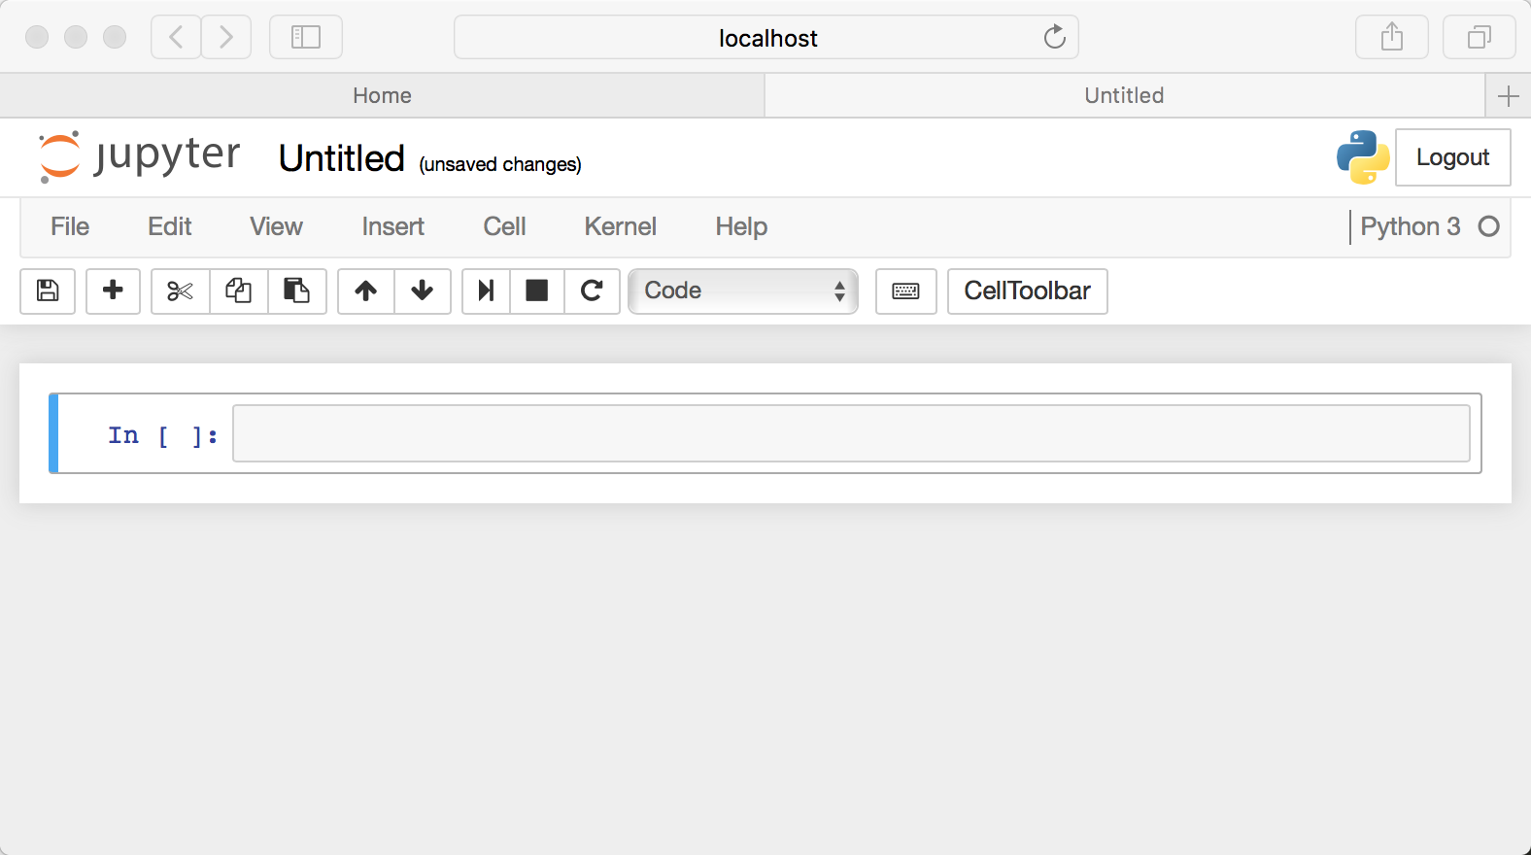
Introduction to Jupyter

Slide 11
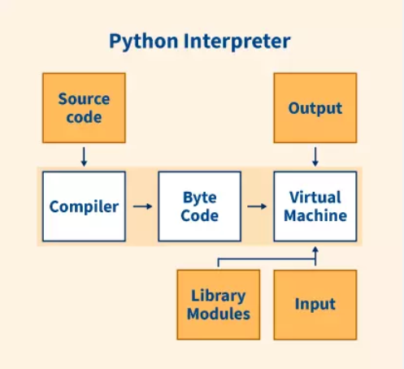
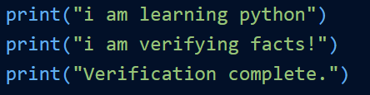
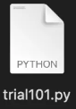
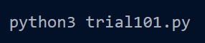
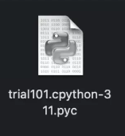
Python is Interpreted and Compiled Both
Step1: Create a simple python code
Step2: Save the file with .py extension
Step3: Open the terminal and try running the
Program
Step4: A folder named pycache is being generated. Which contains a file named trial101.cpython-311.pyc, which is byte code generated after compilation.

Slide 12
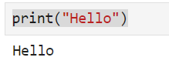
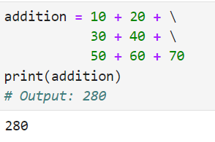
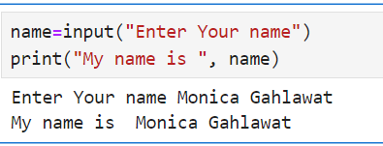
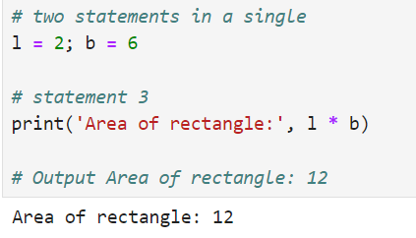
Practice Programs
line continuation character (\). This is known as an explicit continuation.
Semi-column to Separate Multiple Statements

Slide 13
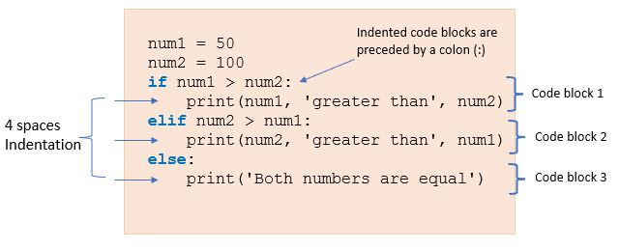
Indentation

Slide 14
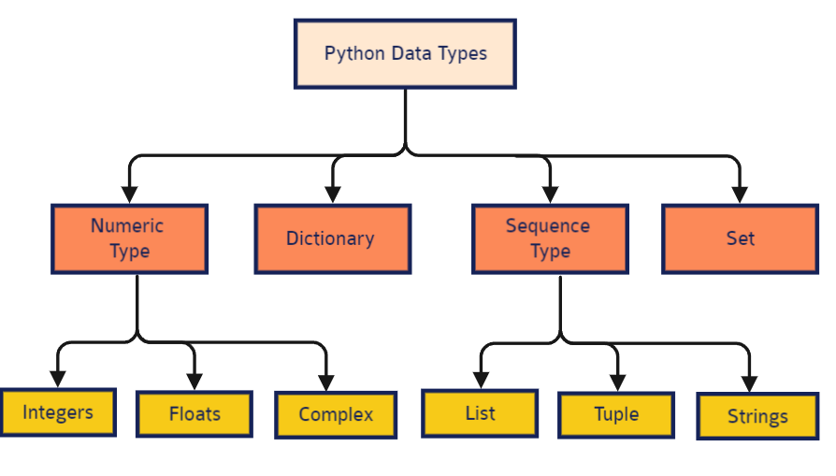
Python Data Types

Slide 15
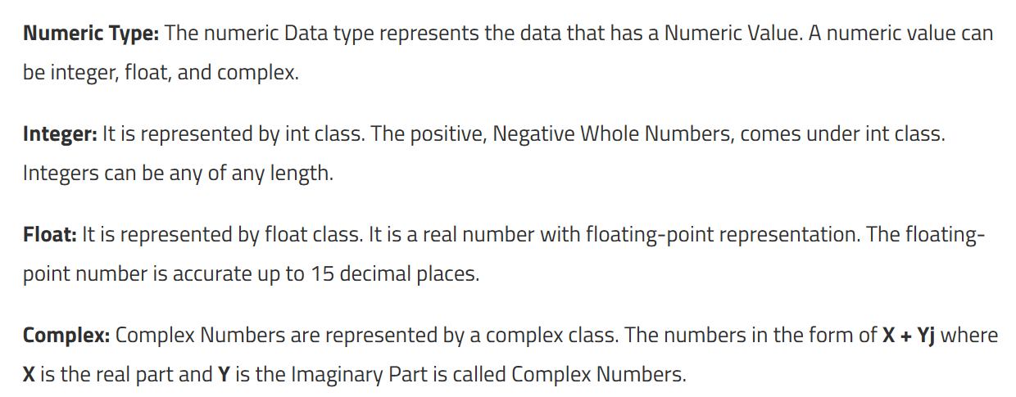
Numeric Data Type

Slide 16
Integer Data Type
In Python, there is effectively no limit to how long an integer value can be. Of course, it is constrained by the amount of memory your system has, as are all things, but beyond that an integer can be as long as you need it to be. Example-
print(4.2)
Output: 4.2
print(123123123123123123123123123123 + 1)
Output: 123123123123123123123123123124

Slide 17
Float data type
The float type in Python designates a floating-point number. float values are specified with a decimal point. Optionally, the character e or E followed by a positive or negative integer may be appended to specify scientific notation. Example -
print(4.2)
Output: 4.2
print(5.68 – 1.21)
Output: 4.47

Slide 18
String Data Type (str)
In Python, Strings are arrays of bytes representing Unicode characters. A string is a collection of one or more characters put in a single quote, double-quote or triple quote. In python there is no character data type, a character is a string of length one. It is represented by str class.
Strings in Python can be created using single quotes or double quotes or even triple quotes. Ex –
String1 = ‘Python Programming’
print(String1)
Output – Python Programming

Slide 19
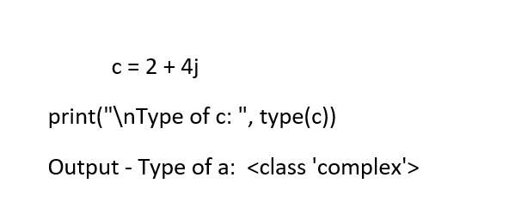
Type Function
type() function is used to determine the type of data type.Ex –
a = 5
print("Type of a: ", type(a))
Output - Type of a: <class 'int'>
b = 5.0
print("\nType of b: ", type(b))
Output - Type of a: <class 'float'>

Slide 20
Boolean data type(bool)
Python provides a Boolean datatype. Objects of Boolean type may have one of two values, True or False. Example –
print(type(True) / print(type(False))
Output - <class 'bool'>

Slide 21
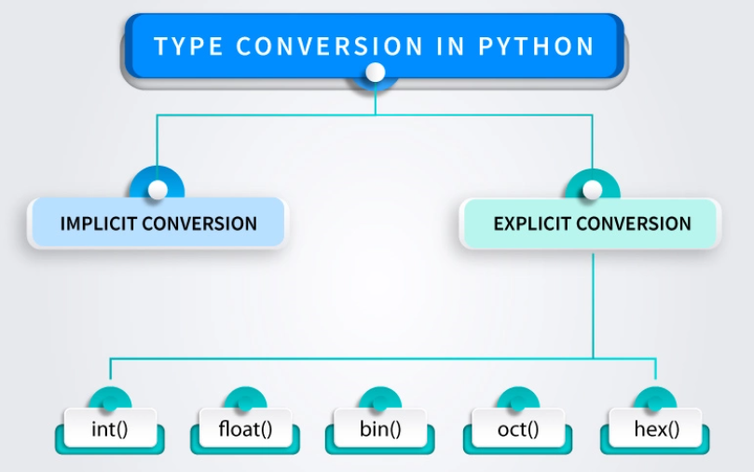
Type Casting

Slide 22
Implicit Type Casting
Python converts data type into another data type automatically. In this process, users don’t have to involve in this process. Ex -
a = 7
b = 3.0
c = a+b
print(c)
print(type(c))
Output - 10.0
<class 'float'>

Slide 23
Explicit Type Casting
In this method, Python need user involvement to convert the variable data type into certain data type in order to the operation required. Mainly in type casting can be done with these data type function:
Int() : Int() function take float or string as an argument and return int type object.
float() : float() function take int or string as an argument and return float type object.
str() : str() function take float or int as an argument and return string type object.

Slide 24
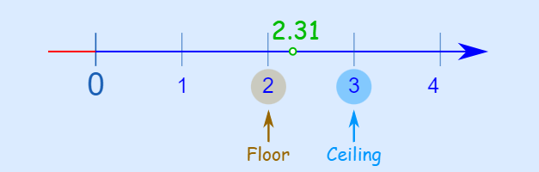
Arithmetic Operator
Arithmetic operators are used with numeric values to perform common mathematical operations:
Operator | Name | Syntax | Example
+ | Addition | x+y | print(5 + 3) gives 8
- | Subtraction | x-y | print(5-3) gives 2
* | Multiplication | x*y | print(5*3) gives 15
/ | Division | x/y | print(5/3) gives 1.6666
% | Modulus | x%y | print(5%3) gives 2
** | Exponentiation | x**y | print(5**3) gives 125
// | Floor division | x//y | print(5//3) gives 1

Slide 25
Assignment Operator
Assignment operators are used to assign values to variables:
Operator | Example | Same As | output
= | x = 5 | x = 5 | x=5
+= | x += 3 | x = x + 3 | x=5+3 gives 8
–= | x –= 3 | x = x – 3 | x=8-3 gives 5
*= | x *= 3 | x = x * 3 | x=5*3 gives 15
/= | x /= 3 | x = x / 3 | x=15/3 gives 5
%= | x %= 3 | x = x % 3 | x=5%3 gives 1
//= | x //= 3 | x = x // 3 | x= 1//3 gives 0
**= | x **= 3 | x = x ** 3 | x=0**3 gives 0

Slide 26
Assignment Operator
Suppose x=5
Operator | syntax | Same As | output
&= | x &= 3 | x = x & 3 | x=5&3 gives 1
|= | x |= 3 | x = x | 3 | x=5|3 gives 7
^= | x ^= 3 | x = x ^ 3 | x=5^3 gives 6
>>= | x >>= 3 | x = x >> 3 | x=5>>3 gives 0
<<= | x <<= 3 | x = x << 3 | x=5<<3 gives 40

Slide 27
Comparison Operator
Comparison operators are used to compare two values:
Consider x=5 and y=3 Note: All +ve or –ve values are True and 0 is false
Operator | Name | Example | output
== | Equal | x == y | print(x==y) gives false
!= | Not equal | x != y | print(x!=y) gives true
> | Greater than | x > y | print(x>y) gives true
< | Less than | x < y | print(x<y) gives false
>= | Greater than or equal to | x >= y | print(x>=y) gives true
<= | Less than or equal to | x <= y | print(x<=y) gives false

Slide 28
Logical Operator
Logical operators are used to combine conditional statements:
Operator | Description | Example
and | Returns True if both statements are true | x < 5 and x < 10
or | Returns True if one of the statements is true | x < 5 or x < 10
not | Reverse the result, returns False if the result is true | not(x < 5 and x < 10)

Slide 29
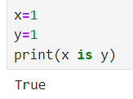
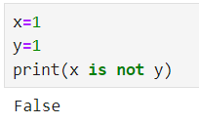
Identity Operator
Identity operators are used to compare the objects, not if they are equal, but if they are actually the same object, with the same memory location:
Operator | Description | Example
is | Returns True if both variables are the same object | x is y
is not | Returns True if both variables are not the same object | x is not y

Slide 30
Membership Operator
Membership operators are used to test if a sequence is presented in an object:
Operator | Description | Example
in | Returns True if a sequence with the specified value is present in the object | x in y
not in | Returns True if a sequence with the specified value is not present in the object | x not in y

Slide 31
Bitwise Operator
Bitwise operators are used to compare (binary) numbers:
Operator | Name | Description
& | AND | Sets each bit to 1 if both bits are 1
| | OR | Sets each bit to 1 if one of two bits is 1
^ | XOR | Sets each bit to 1 if only one of two bits is 1
~ | NOT | Inverts all the bits
<< | Zero fill left shift | Shift left by pushing zeros in from the right and let the leftmost bits fall off
>> | Signed right shift | Shift right by pushing copies of the leftmost bit in from the left, and let the rightmost bits fall off

Slide 32
Ternary Operator
Ternary operators are also known as conditional expressions are operators that evaluate something based on a condition being true or false.
It simply allows testing a condition in a single line replacing the multiline if-else making the code compact.
Syntax : [on_true] if [expression] else [on_false]
Example : a,b = 10,20
min = a if a<b else b
print(min)
Output - 10

Slide 33
Operator Precedence
Operator | Description | Associativity
( ) | Parentheses | left-to-right
** | Exponent | right-to-left
* / % | Multiplication / Division / modulus | left-to-right
+ – | Addition / Subtraction | left-to-right
<< >> | Bitwise shift left / Bitwise shift right | left-to-right
< <= > >= | Relational less than / less than equal to, Relational greater than / greater than equal to, | left-to-right
== != | Relational is equal to / is not equal to | left-to-right
is, is not in, not in | Identity Membership operators | left-to-right
& | Bitwise AND | left-to-right

Slide 34
Operator Precedence
Operator | Description | Associativity
^ | Bitwise exclusive OR | left-to-right
| | Bitwise inclusive OR | left-to-right
not | Logical NOT | right-to-left
and | Logical AND | left-to-right
or | Logical OR | left-to-right
= += -= *= /= %= &= ^= |= <<= >>= | Assignment Addition/subtraction assignment Multiplication/division assignment Modulus/bitwise AND assignment Bitwise exclusive/inclusive OR assignment Bitwise shift left/right assignment | right-to-left

Slide 35
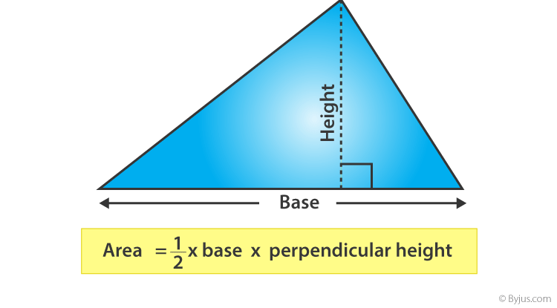
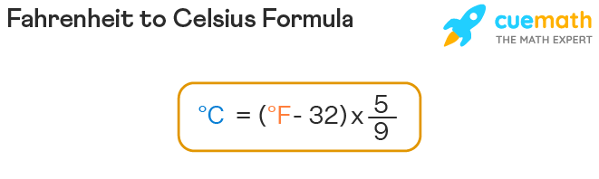
Assignment
Python Program to Print Hello world!
Python Program to Add Two Numbers
Python Program to Calculate the Area of a Triangle
Python Program to Swap Two Variables without using 3rd variable
Python Program to Convert Celsius To Fahrenheit and vice versa

Slide 36
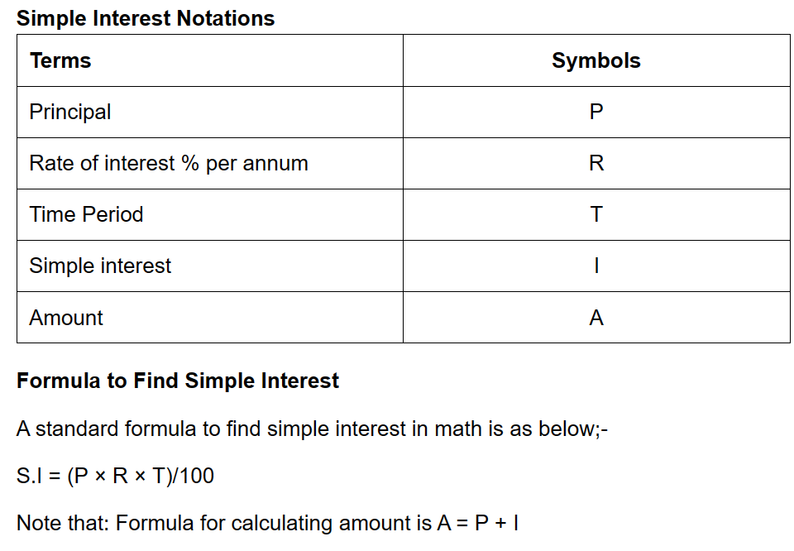
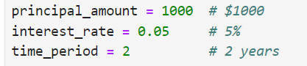
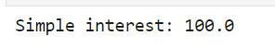
Python Program to calculate simple interest

Slide 37
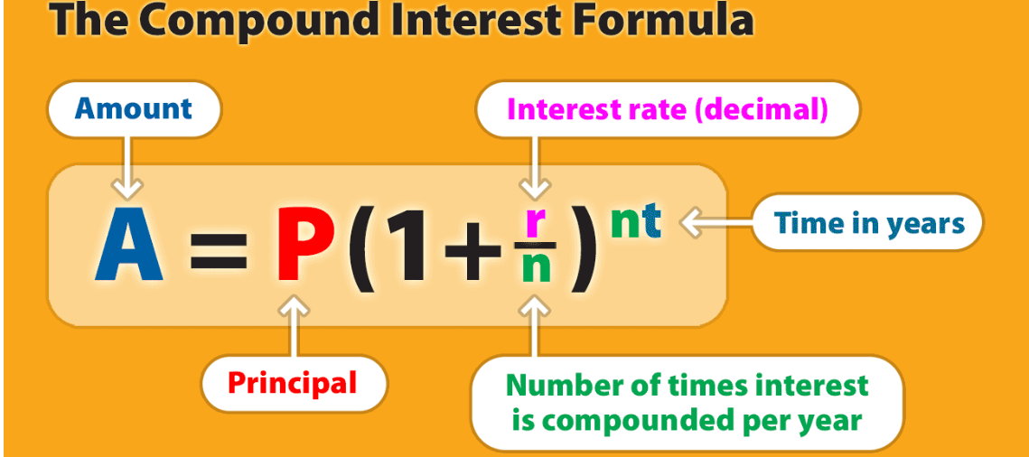
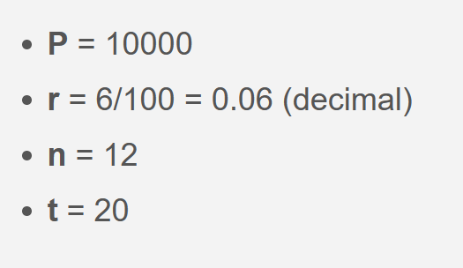
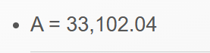
Python Program to calculate Compound interest

Slide 38
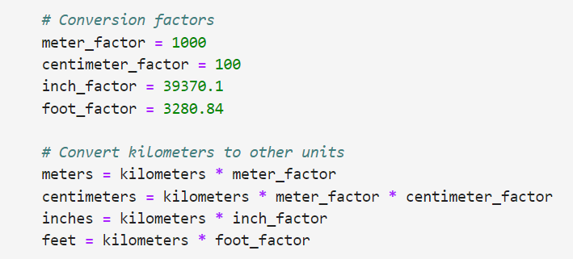
Python Program to Convert Kilometers to meter, centimeters, inch, foot

Slide 39




Contact Us
FLY THE NEST
Connekt,
13TH Floor, Gala Empire, Thaltej,
Ahmedabad, Gujarat, India
+91 6354283836
info@flythenest.in
www.flythenest.in

Slide 40
Thank You

